Slide 1
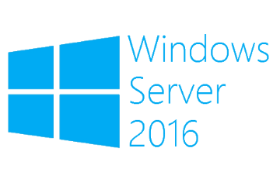
Generation 2 VMs
Megaseries

Slide 2
Info
A new type of virtual machine introduced in Hyper-V on Windows Server 2012 R2
These VMs were designed from the ground up to take advantage of virtualization: they do not try to emulate legacy hardware since they ‘know’ they are VMs
These machines use UEFI instead of BIOS as Generation 1 machines (or machines on WS2012) and support UEFI features like Secure Boot
Generation 2 VMs support operating systems starting with Windows Server 2012/Windows 8 and only the 64 bit versions

Slide 3
Hardware
Most of the legacy devices that were emulated were replaced by synthetic drivers and software based devices
There is no more IDE controller; VMs can boot from the SCSI controller now
PXE boot is supported on the standard network adapter; the legacy network adapter is gone from Generation 2

Slide 4
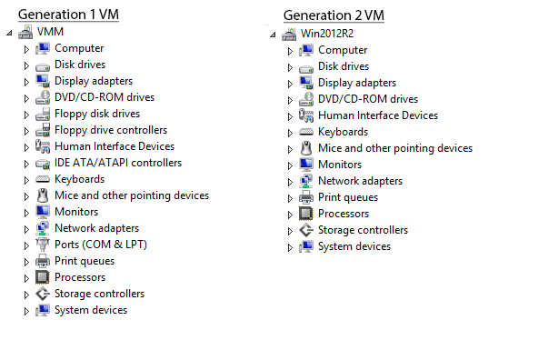
Hardware

Slide 5
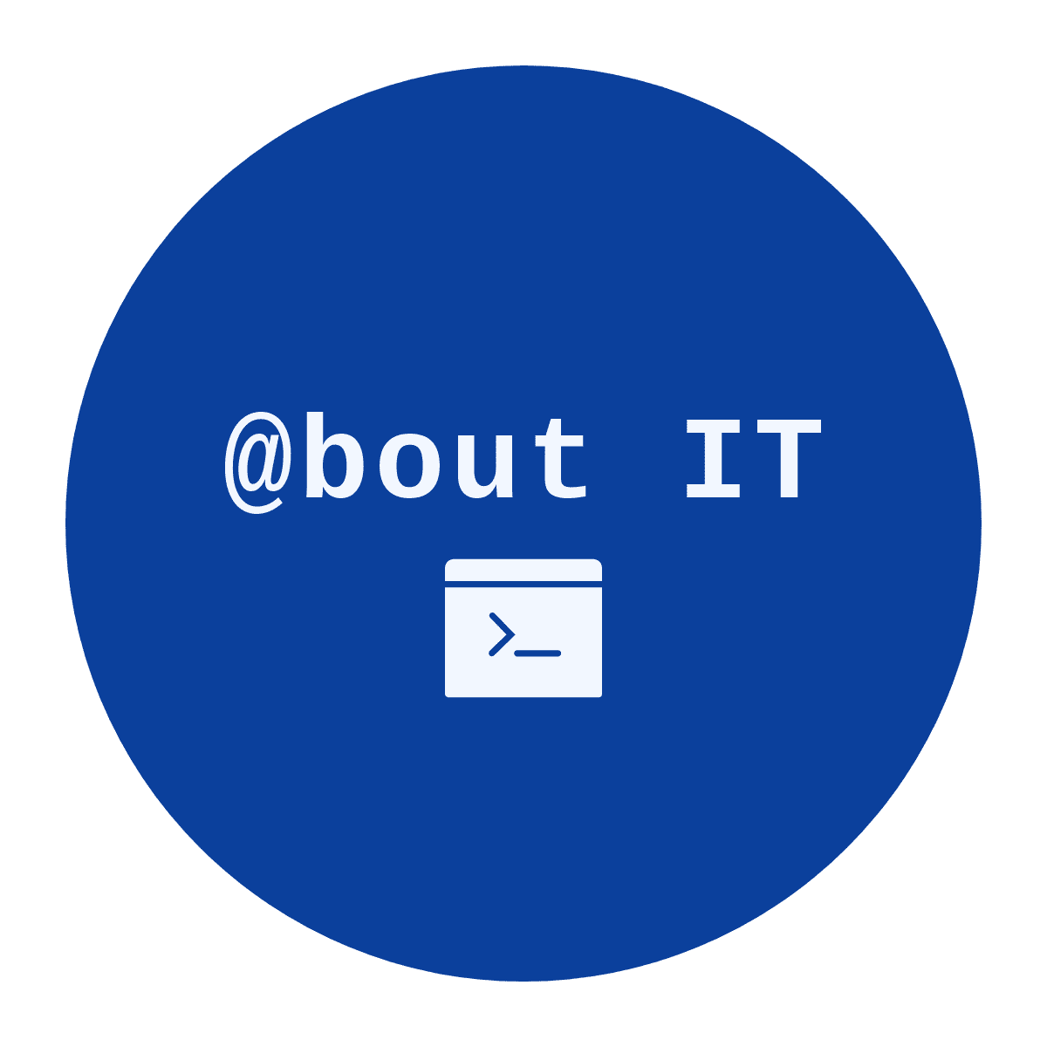
https://www.youtube.com/channel/UCcZ-jLbPwNr8E_v9-65n8Iw https://github.com/itknowledge4

